Slide 1
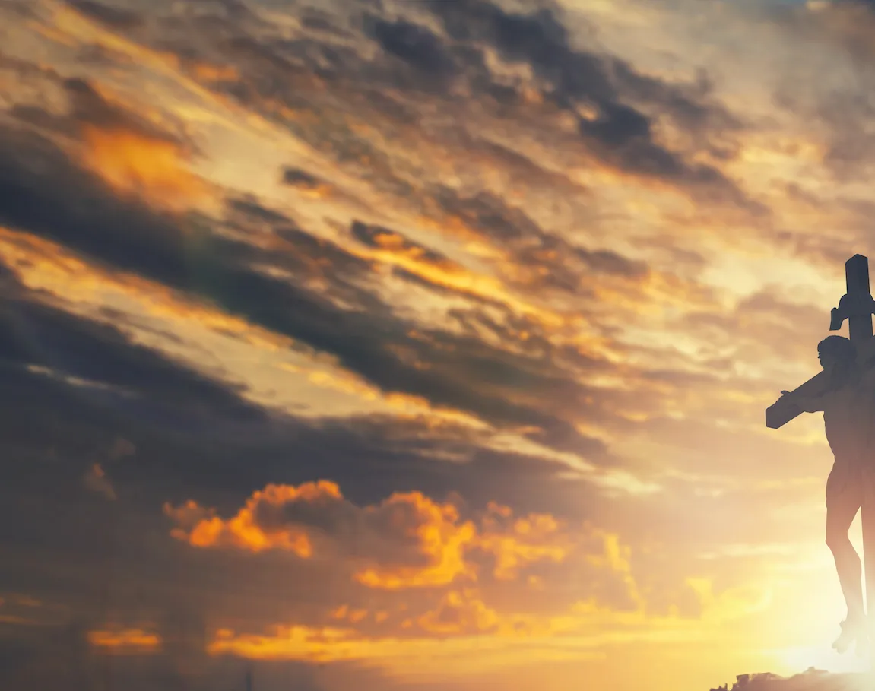
Nearer My God To Thee

Slide 2
G C G D
Nearer, my God, to Thee Nearer to Thee
Em C G D G
Even though it be a cross That raiseth me
Em C Em D
Still all my song shall be Nearer, my God, to Thee
G C G D G
Nearer my God to Thee, nearer to Thee

Slide 3
G C G D
Though, like the wanderer The sun gone down
Em C G D G
Darkness be over me My rest a stone
Em C Em D
Yet in my dreams I'd be Nearer, my God, to Thee
G C G D G
Nearer my God to Thee, nearer to Thee

Slide 4
G C G D
Then, with my waking thoughts Bright with Thy praise
Em C G D G
Out of my stony griefs Bethel I'll raise
Em C Em D
So by my woes to be Nearer, my God, to Thee
G C G D G
Nearer my God to Thee, nearer to Thee

Slide 5
G C G D
There in my Father’s home, safe and at rest,
Em C G D G
There in my Savior’s love, perfectly blest;
Em C Em D
Age after age to be Nearer my God to Thee
G C G D G
Nearer my God to Thee, nearer to Thee
END

